Slide 1
COVID-19 MITRE Ventilator Response
Michael Kouremetis, William Booth

Slide 2
Our Solution addresses the dual Challenge
Encourages multi-state resource sharing of existing ventilators by creating a system where hospitals are incentivized to provide all their non-essential ventilators
Optimizes distribution of ventilators by estimating severe COVID-19 cases by geography and time and matching the existing supply to meet demand

Slide 3
Artifacts Produced
COVID-19 Ventilator Usage Prediction Model
COVID-19 Ventilator Distribution Algorithm
Integration with Google Maps API
Python modules and scripts that operationalize following workflow:
Load Ventilator Inventory
Predict Ventilator
Usage
Incorporate Google Maps distance data
Run distribution algorithm

Slide 4

Code Library
https://github.com/wbooth/covid
Code is functional and available on GitHub

Slide 5
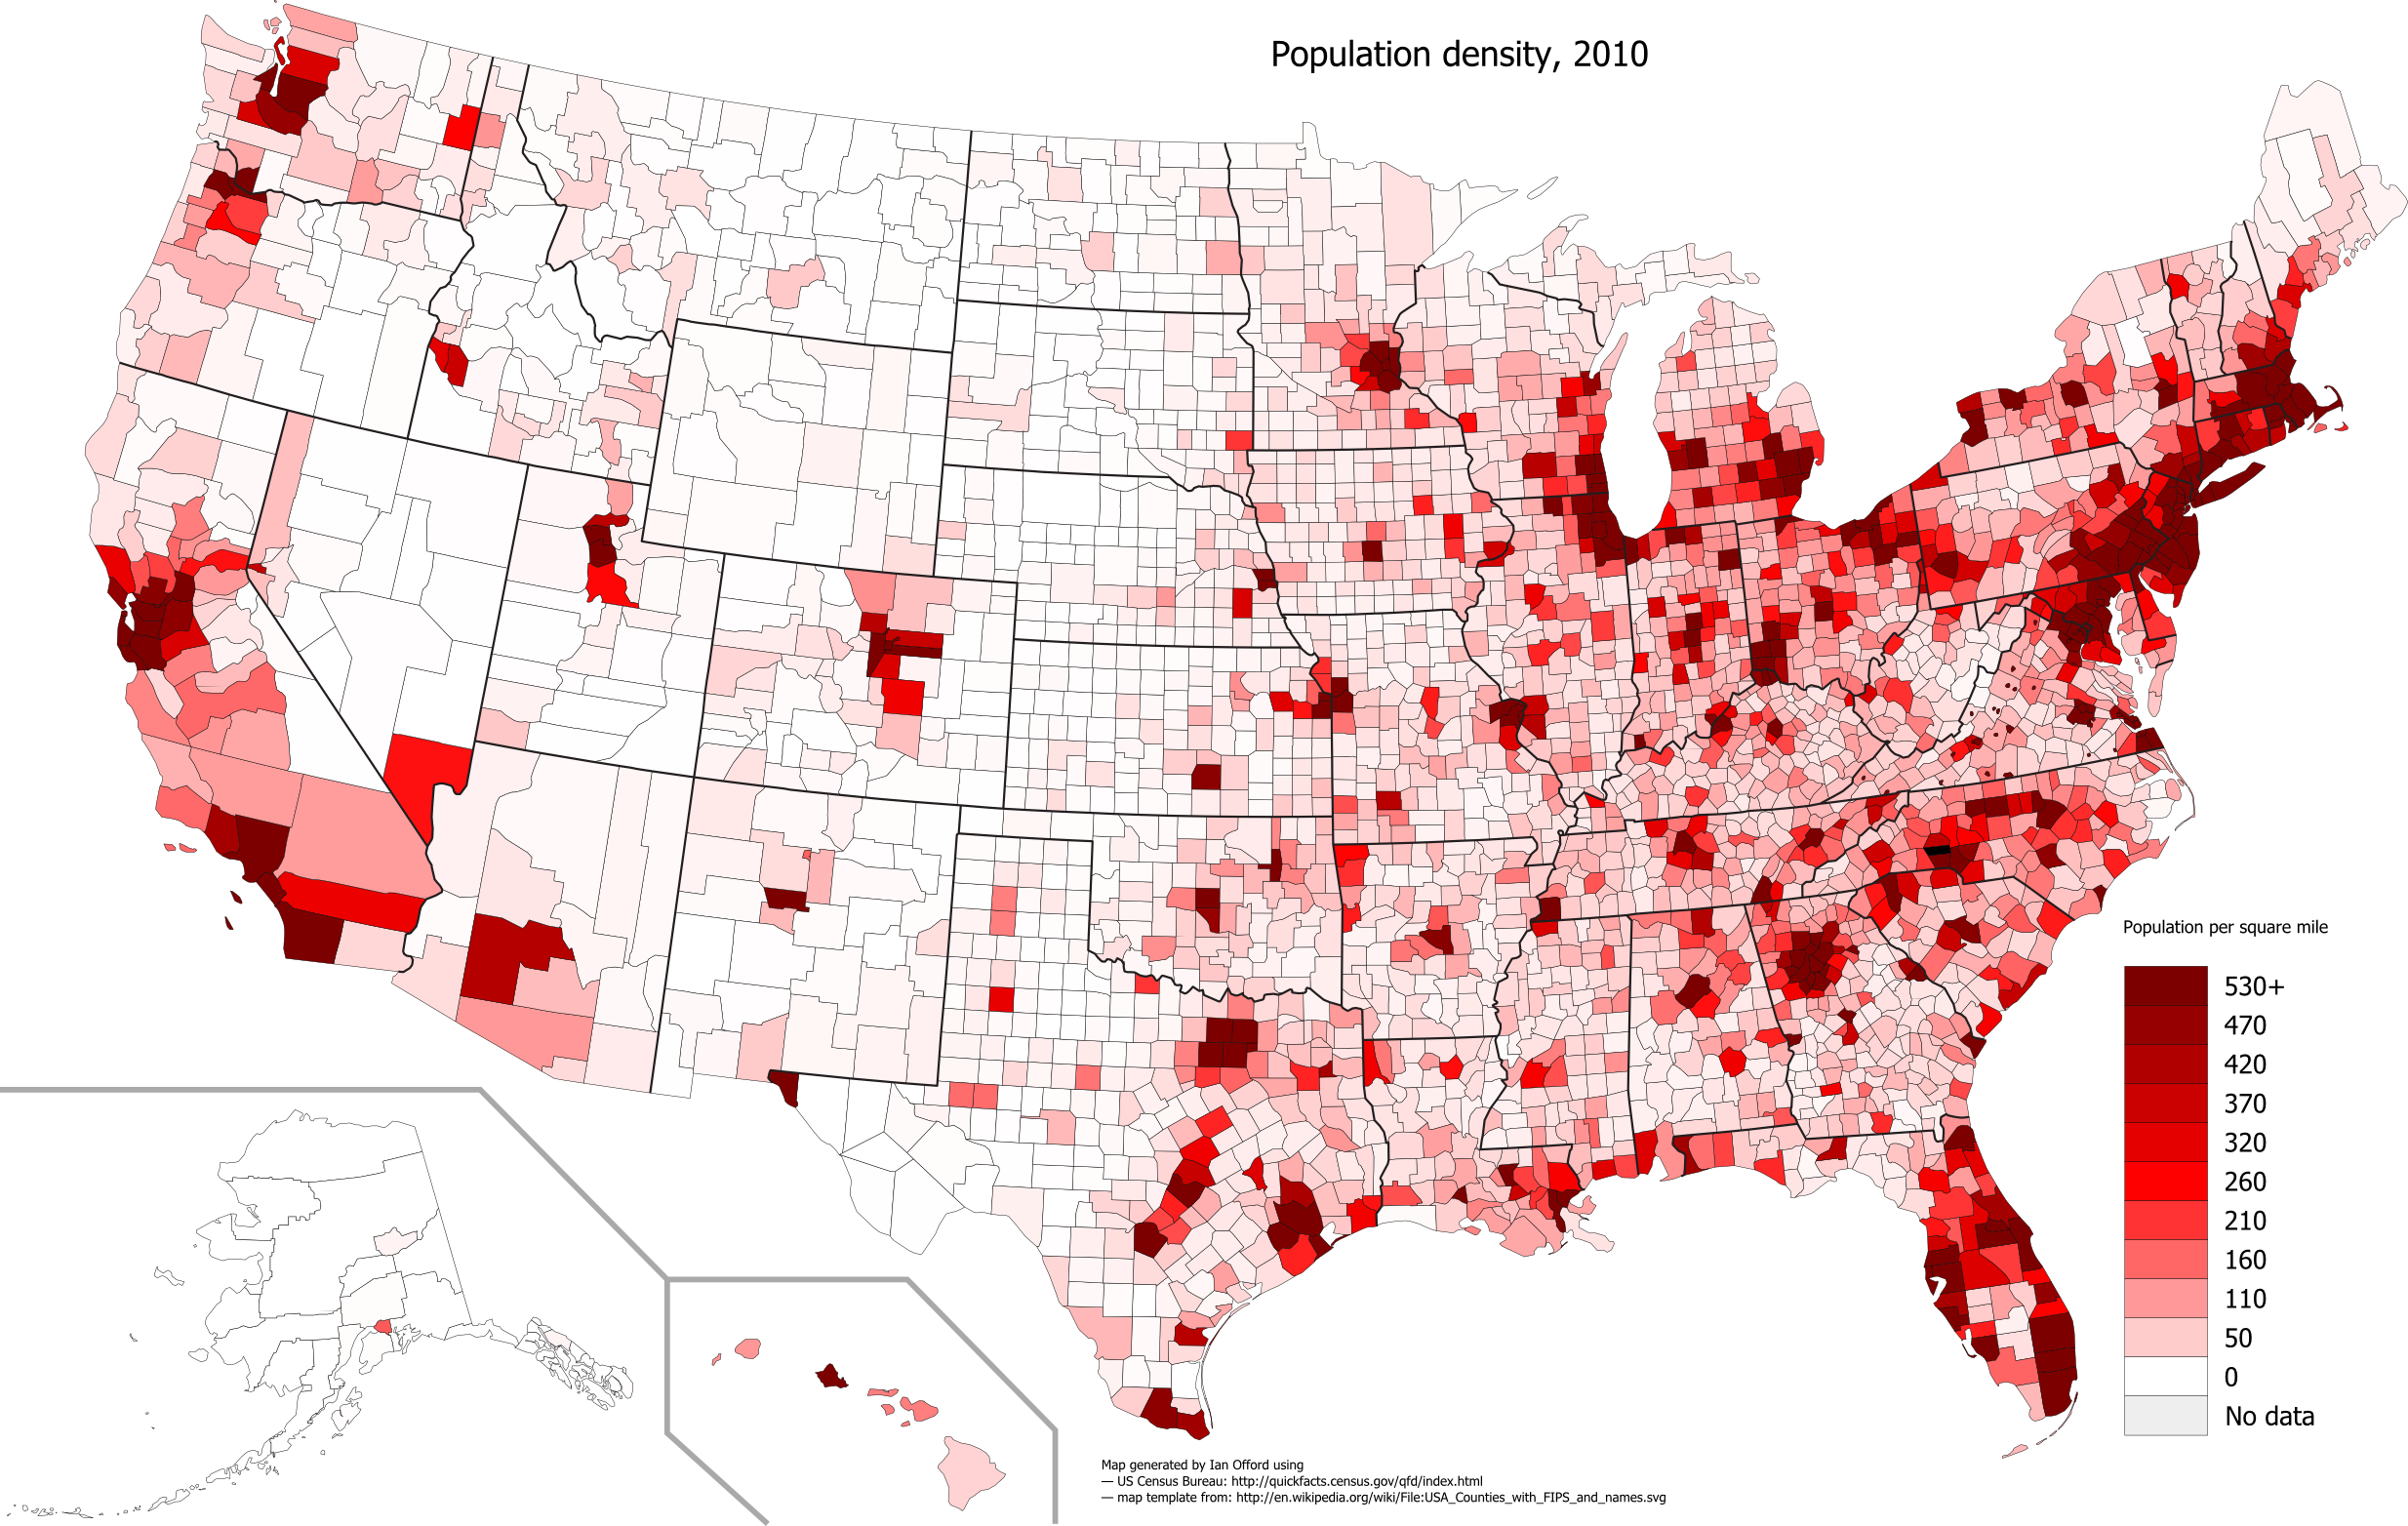
Understanding the Market Size of Ventilators and Expected Need
Source (L): US Census, (R): Johns Hopkins

Slide 6
Sizing Up the Problem
In order to think about the multi state collaboration we had to first:
Think about the # of ventilators in the US
Where those ventilators were located
How many were immediate need vs delayed need (meaning the hospitals were willing to spare them)
In order to think about the distribution, we first had to:
Understand the scope of “severe” COVID cases that required a ventilator
Understand WHERE those cases would be and WHEN they would occur

Slide 7
Predicting Need
To best deploy resources, we must correctly understand the need. To do this, we make a prediction of the # of COVID Cases in the US, SPECIFICALLY considering where and when COVID cases will happen.
*the only cases we are concerned with are those considered “severe” where a ventilator is needed
This is essential to adequately deploy resources to the RIGHT locations at the RIGHT time.

Slide 8
COVID Cases
Cases information is source from Johns Hopkins

Slide 9
COVID Cases Prediction Assumption
We have assumed a normal distribution for cases (for now)
We assume everyone will get it and use confirmed cases as a percentage of population by county to determine where on the curve of COVID cases the county is.
For example, If 1.7% of the county is infected, we can conclude when the peak will be
We would like to add population density and shelter in place protocols to effect the standard deviation. We assume that SIP would increase the standard deviation of time to contract and “lower the curve”

Slide 10
Our considerations for peaks and ventilator need
Outline assumptions being built into the model
Considering general population
Population density
Day COVID started in area
“Regs” around spreading that are flattening the curve

Slide 11
Ventilator Need from COVID Cases
We assume that 6% of confirmed COVID cases will need a ventilator
Source: https://www.nbcnews.com/health/health-news/what-ventilator-critical-resource-currently-short-supply-n1168641
Image Source: NYT

Slide 12
Transaction Costs / Logistics Assumptions
Assumptions of transaction costs (in terms of time) for ventilators to move from one location to next + 30 hours to clean
Hospitals/Counties/States can readily use the services of USPS, FedEx and other priority shippers. Research concluded that physical and timely transportation of ventilators could be filled easily with current market services.
Localities and entities can accurately report their current ventilator inventory OR such information can be gleaned from publicly made information.

Slide 13

The Solution
Knowing the market and having the tools to make predictions we can now solve the two problems:
Incentivizing Resource Sharing
Optimizing Distribution

Slide 14
Incentivizing Collaboration

Slide 15
Incentivizing Multi-State Resource Sharing
Assumption: Hospitals will not want to give up ventilators that they will need
However, hospitals will give up ventilators they don’t need at Time T, if they can be guaranteed ENOUGH ventilators to meet their need at time T+X (“peak” COVID)
This likely means while they won’t give up entire stock, there is a % they’re willing to lend if guaranteed other’s pooled resources when they need it

Slide 16
Solving Distribution

Slide 17
Distribution Challenge
Find the best possible fit of ensuring ventilators are
WHERE they are needed
WHEN they are needed

Slide 18
Ventilator Matching
We have created a mutually beneficially distribution algorithm that considers the logistical and cleaning transaction costs and the expected ventilator need in an area.
The key principle of the distribution algorithm is ventilator locality – locations with available ventilators look to their closest neighbors first to fill need before moving to further neighbors.
The algorithm maximizes usage of the ventilators.
Once we know the current available ventilator inventory over a set of locations (states, counties, hospitals etc…) and current ventilator need we can run the algorithm to find the optimized distribution.

Slide 19
Distribution Algorithm Steps
Load current location and availability of ventilators for next time period. (i.e. "Atlanta has 10 available ventilators")
For every location that has need of ventilators, look first to fill own need with available ventilators at location.
Repeat next sub-steps for DAY_COUNT =[1,2,3] (starting with 1) until available ventilator stock is depleted
Next, for each location that has available ventilators, get list of locations that are < DAY_COUNT day away and still have unfulfilled ventilator need.
randomly shuffle the list of locations (fairness mechanism, location randomly chooses which location to service first, given the list of locations is all the same distance away)
iterate through locations and fill as much ventilator need as possible
Distribution Algorithm code: https://github.com/wbooth/covid/blob/master/ventilator_distribution.py

Slide 20
Fairness in the Distribution Algorithm
The distribution algorithm also has default fairness codified into it. When locations look to service ventilator need of other locations, they randomize the order in which they fulfill the ventilator need for locations at the same distance away.
However, the distribution algorithm can also enforce defined levels of guaranteed fairness if required. For instance, if policy dictates that all locations must have a certain level or percentage of ventilators, then the distribution algorithm can be set to enforce a level of fairness (still with optimal distribution) first and then also optimize the distribution of any remaining available ventilators.
E.g. “All locations must have equal share of 70% of available ventilators. For remaining 30%, optimize the distribution with no restrictions”

Slide 21
Other Features We Will Add:
Ventilator Registry
Improved COVID cases model
Allow for plug-and-play of different prediction models
Comparison
Certain models prove more accurate over time

Slide 22
Time To Impact
The primary obstacle to implementation is the willingness for localities and entities (states, counties, hospitals) to commit to the solution and share required information.
Theoretical Timeline: 1 week
Realistic Timeline: 2-3
Technical solution proposed is centered around information sharing and further further technical implementation/testing of simple scripts.
1 week

Slide 23
Thank you.
Questions? Contact Michael Kouremetis & William Booth

